Slide 1

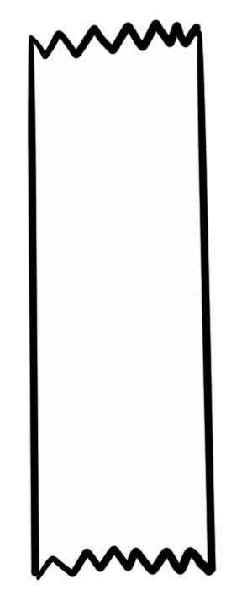
Unit 5 Lesson 1 - Activity
appendItem(list, item)
Adds an element to the end of the list
A new index is added to the list to create a place for the element
The new item is placed in this new index
myNumbers
00 var myNumbers = [10];
01 appendItem(myNumbers,50);
02 appendItem(myNumbers,100);
10
0
myNumbers
10
50
0
1
myNumbers
Do This: Discuss what the list will contain after line 02 runs.
10
50
100
0
1
2

