Slide 1
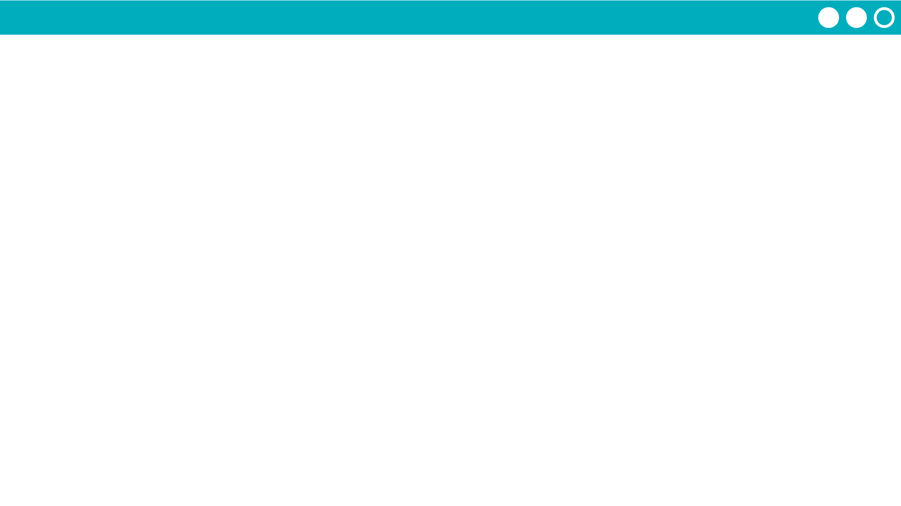
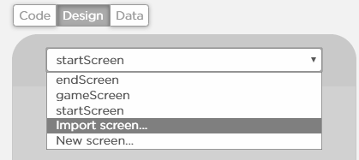
Unit 5 Lesson 15 - Activity
Hackathon Project
Step 6: Build:
Programmers: Use the table to guide you in adding programming statements to your program.
Designers: Use the chart to guide you in adding screen elements to your program. You can work on a separate computer from your partner.
When you have finished screens, your partner should delete the test screens and then import the finished screens (see the next slide for instructions).
Note: If screens are not deleted before importing the project you will get an error message because element IDs will be the same.
Designers - if you finish early, start pair programming with the programmer.

