Slide 1
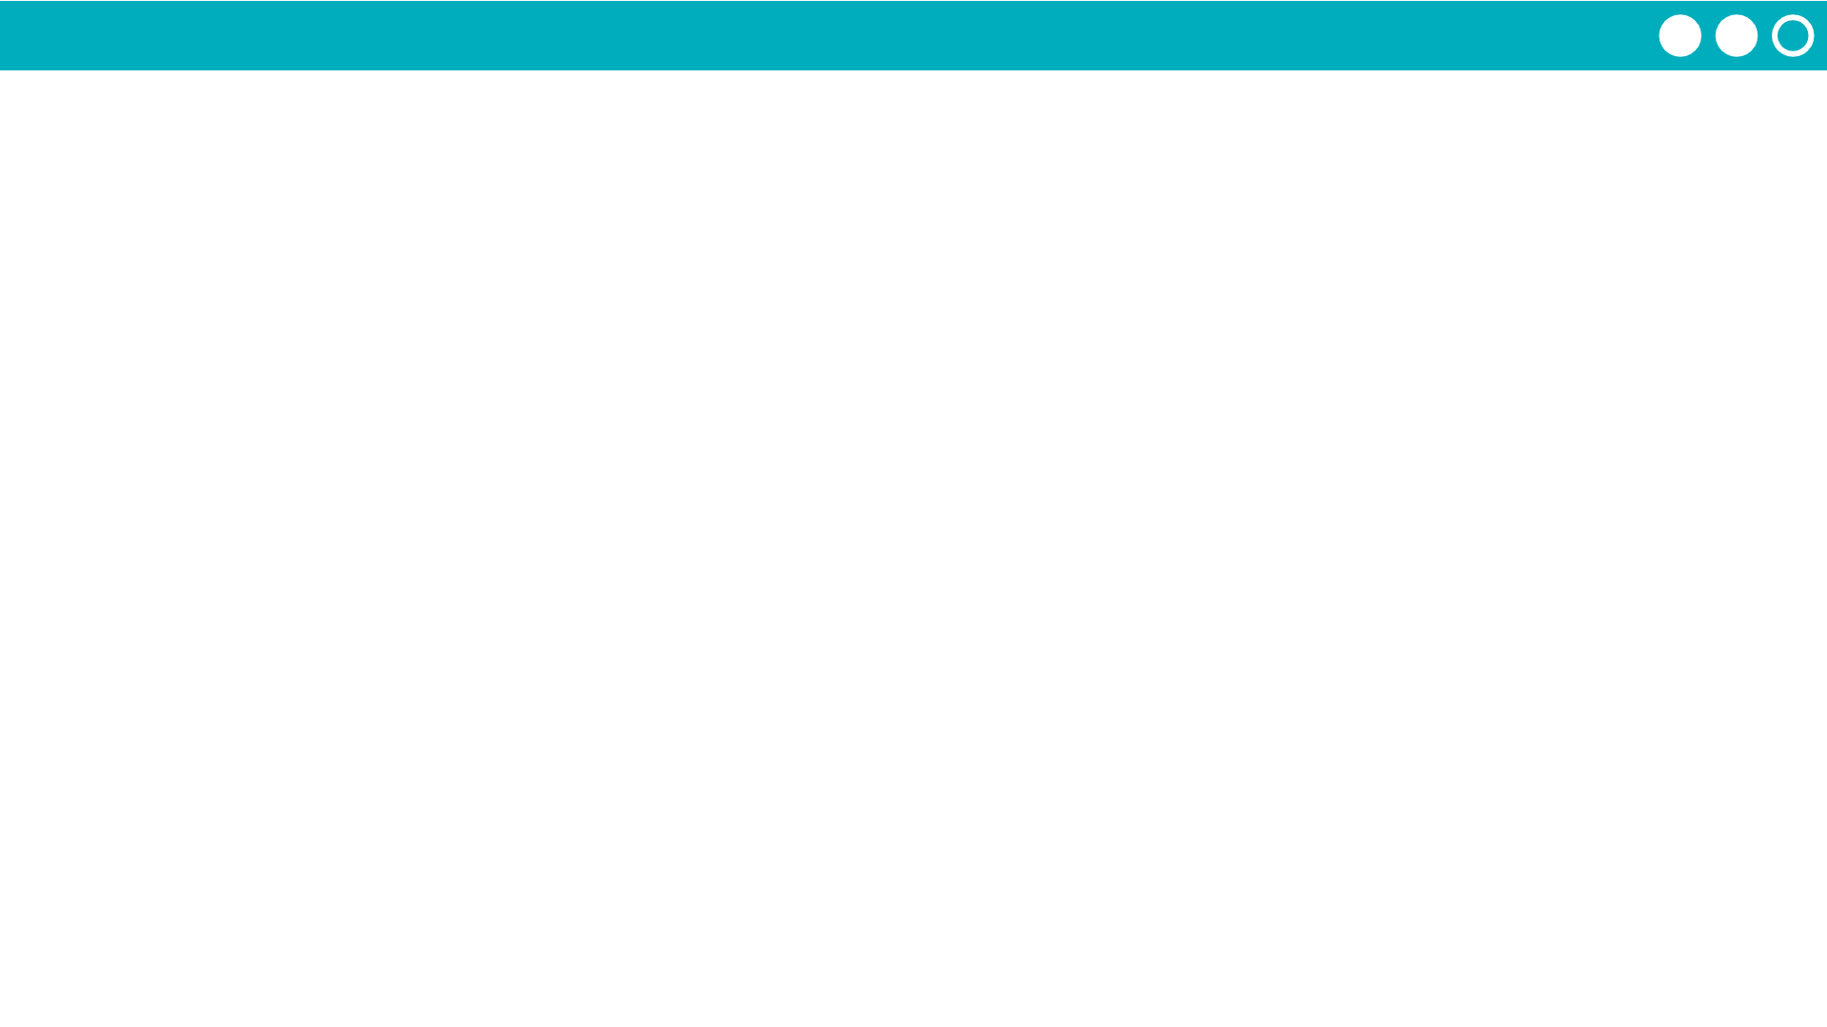
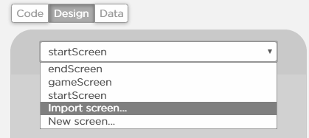
Unit 5 Lesson 16 - Activity
Hackathon Project
Step 6: Build:
Programmers: Use the chart to guide you in adding programming statements to your program.
Designers: Use the chart to guide you in adding screen elements to your program. You can work on a separate computer from your partner.
When you have finished screens, your partner should delete the test screens and then import the finished screens.
Note: If screens are not deleted before importing the project you will get an error message because element IDs will be the same. To avoid this, add a blank screen, delete the old project screens, import the finished screens, and delete the blank screen. Make sure to set your home screen to be the default.
NOTE: When designers finish the screens, they should start pair programming with their partner.
Designers - if you finish early, start pair programming with the programmer.

