Slide 1

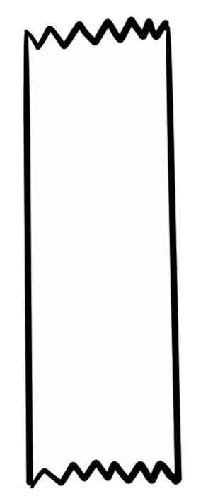
Unit 5 Lesson 1 - Activity
insertItem(list, index, item)
Inserts an element into a list at the index given
A new index is added to the list so there’s space for the new element
The new element is placed at the index given, all other items move right
00 var nums = [10,50];
01 insertItem(nums,1,20);
02 insertItem(nums,1,100);
nums
10
50
0
1
nums
10
20
50
0
1
2
nums
Do This: Discuss what the list will contain after line 02 runs.
10
100
20
50
0
1
2
3

