Slide 1
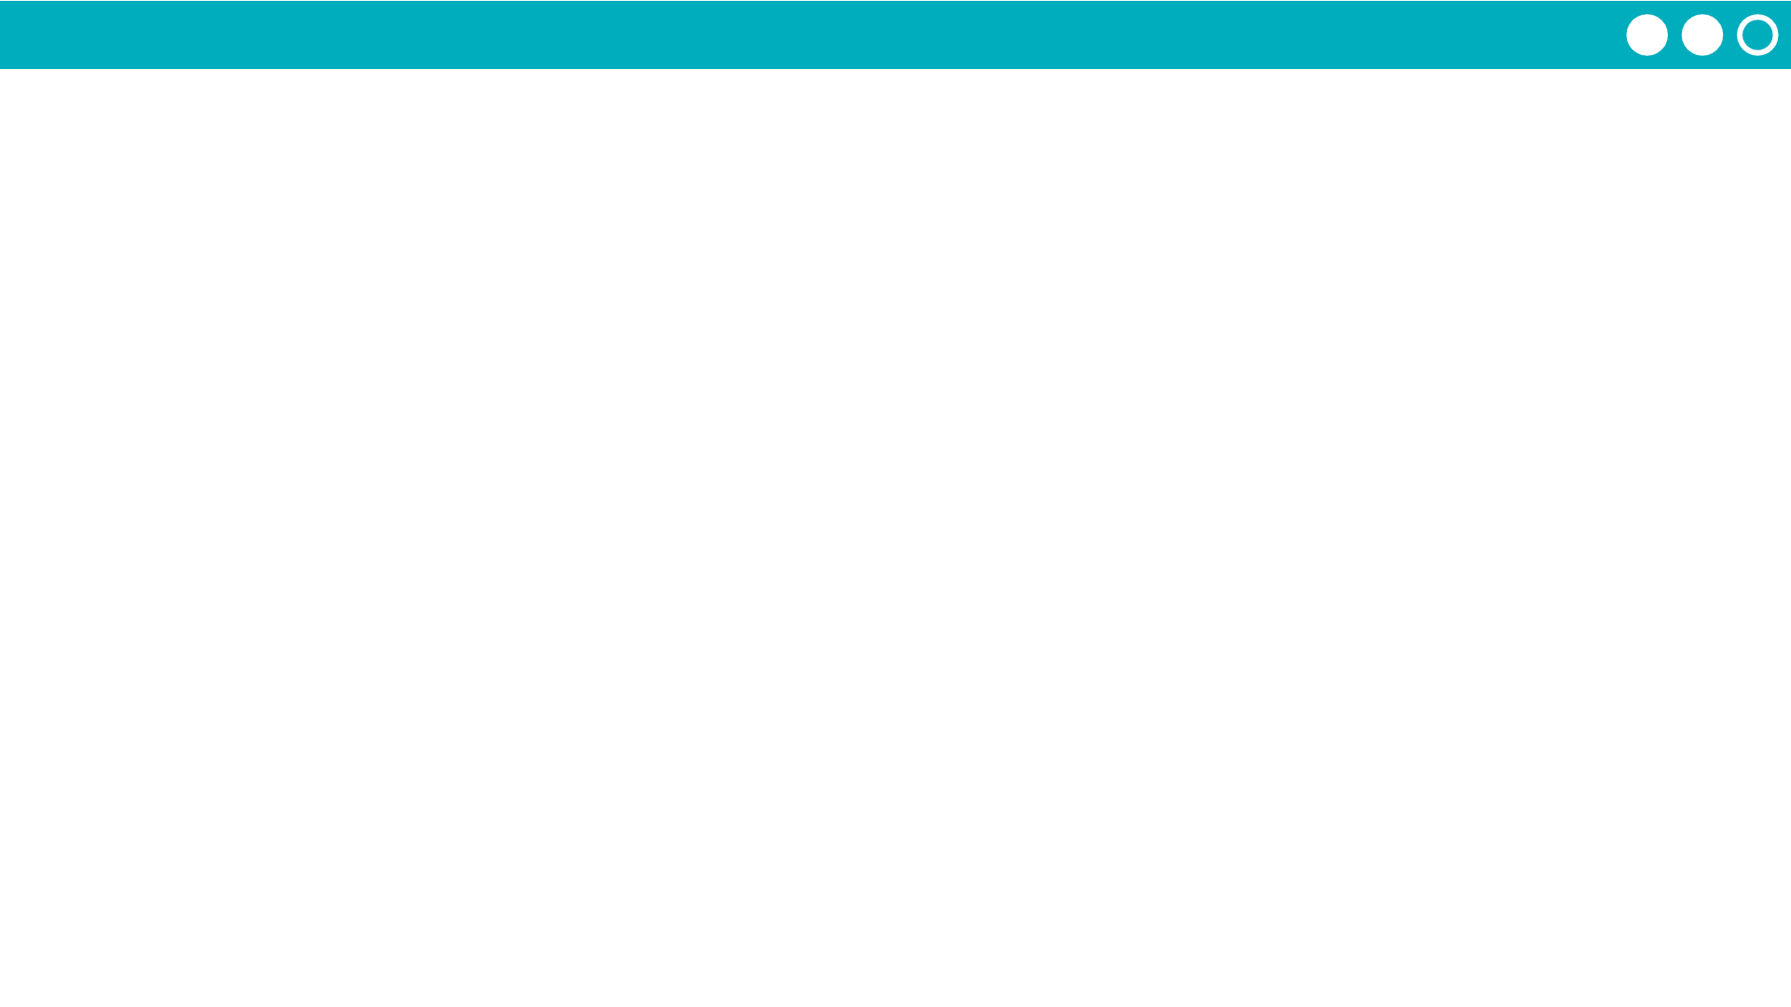
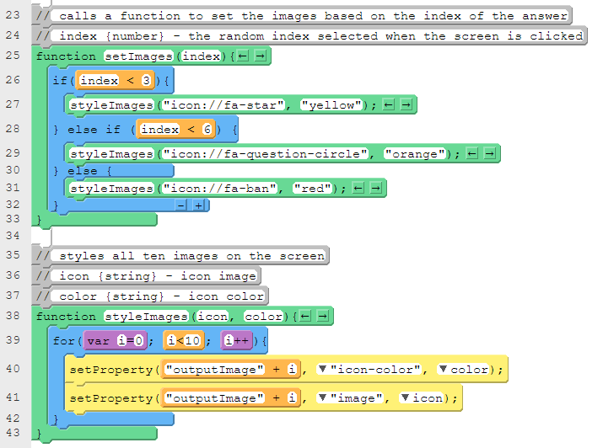
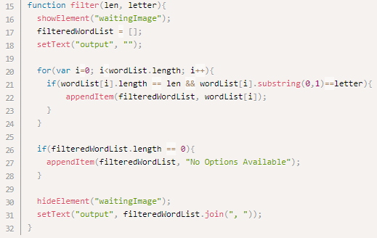
Unit 5 Lesson 17 - Activity
On your Written Response, you will need to take screenshots of code segments.
What's a code segment?
a collection of program statements that are part of a program

