Slide 1

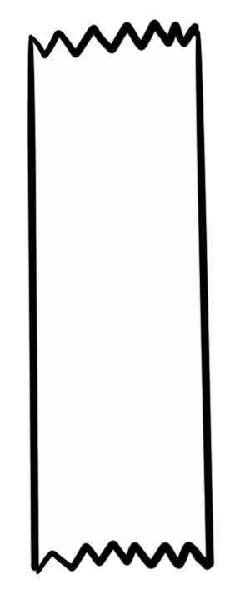
Unit 5 Lesson 1 - Activity
Do This:
Run this program. Compare your result with another group.
What is the length of the list at the end?
Command Reference
removeItem(list, index)
appendItem(list, item)
insertItem(list, index, item)
00 var aList = [20, “hat”, “pow”];
01 appendItem(aList, 5);
02 appendItem(aList, 10);
03 removeItem(aList, 1);
04 insertItem(aList, 2, “bang”);
The length of the list is 5 (one greater than the last index)
aList
20
“pow”
“bang”
5
10
0
1
2
3
4

