Slide 1

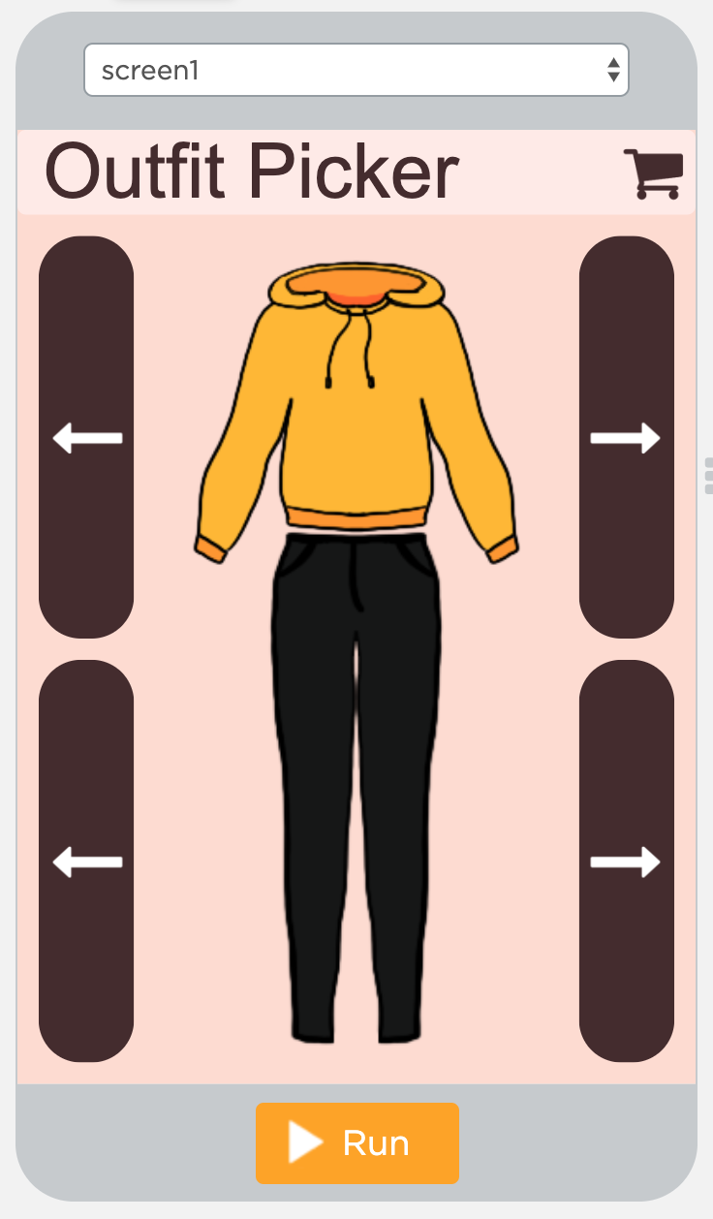
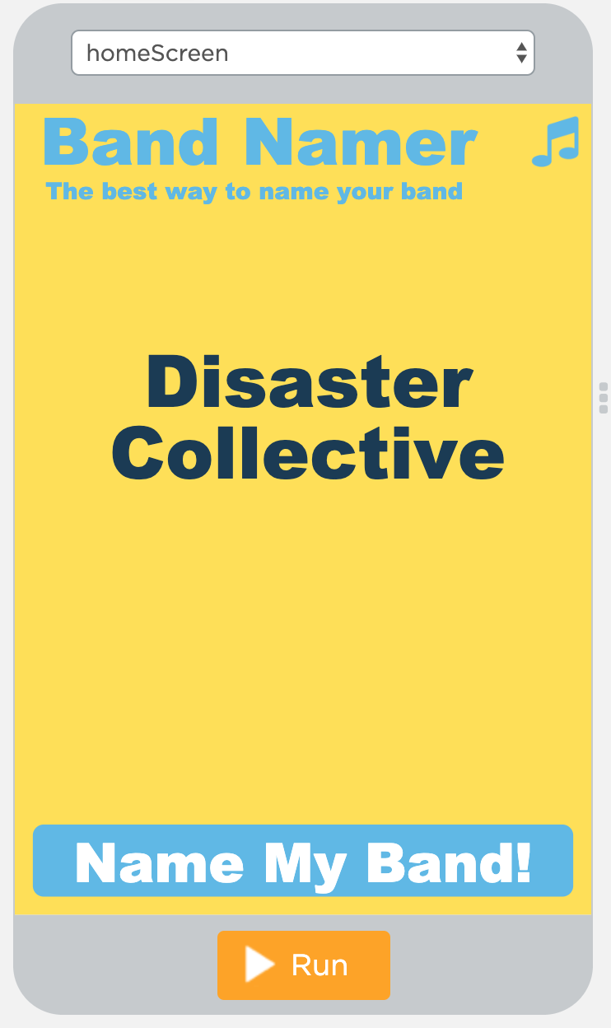
Unit 5 Lesson 2 - Activity
Do This:
Find a partner
Choose either the Outfit Picker or the Band Namer
Read the program with your partner
Respond to all the questions for your app
Be ready to share your responses and what you learned with another group.

