Slide 1

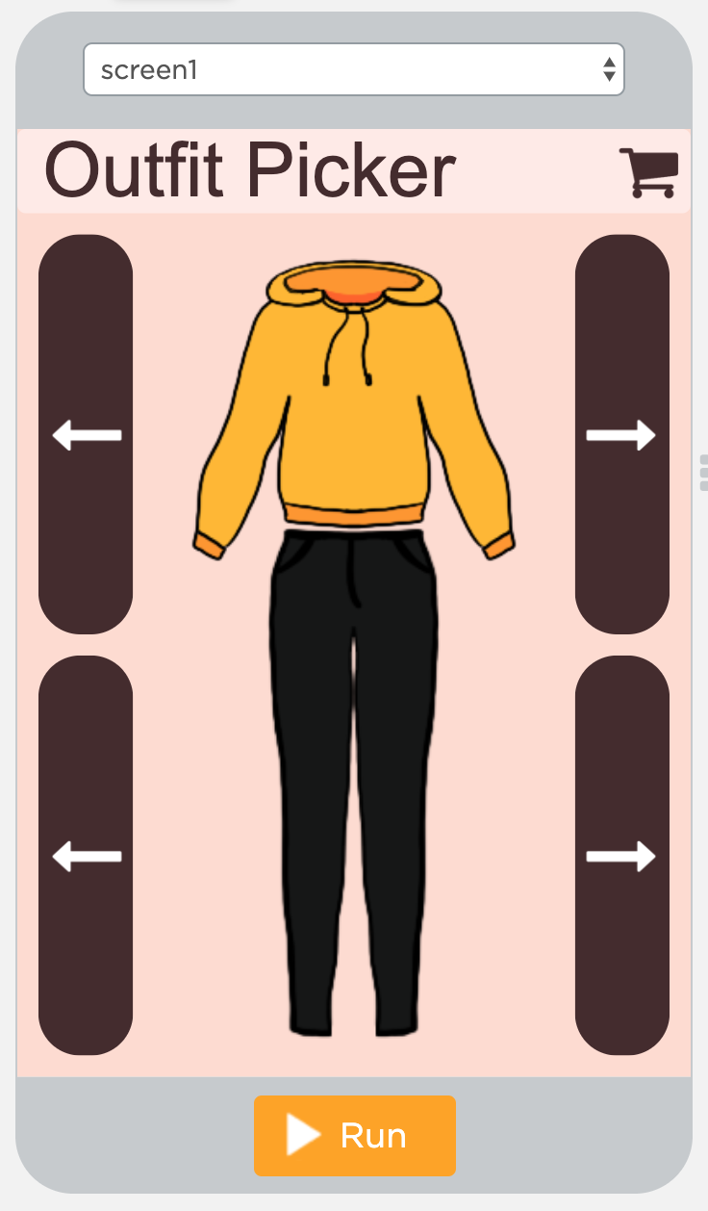
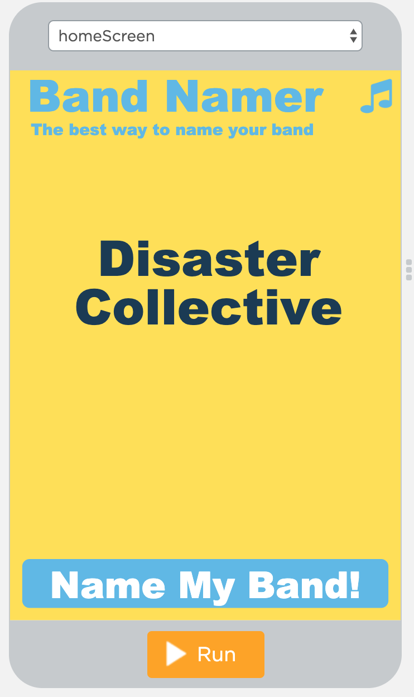
Unit 5 Lesson 2 - Activity
Discuss: Spend 3-4 minutes explaining your app to another group. Then switch.

