Slide 1

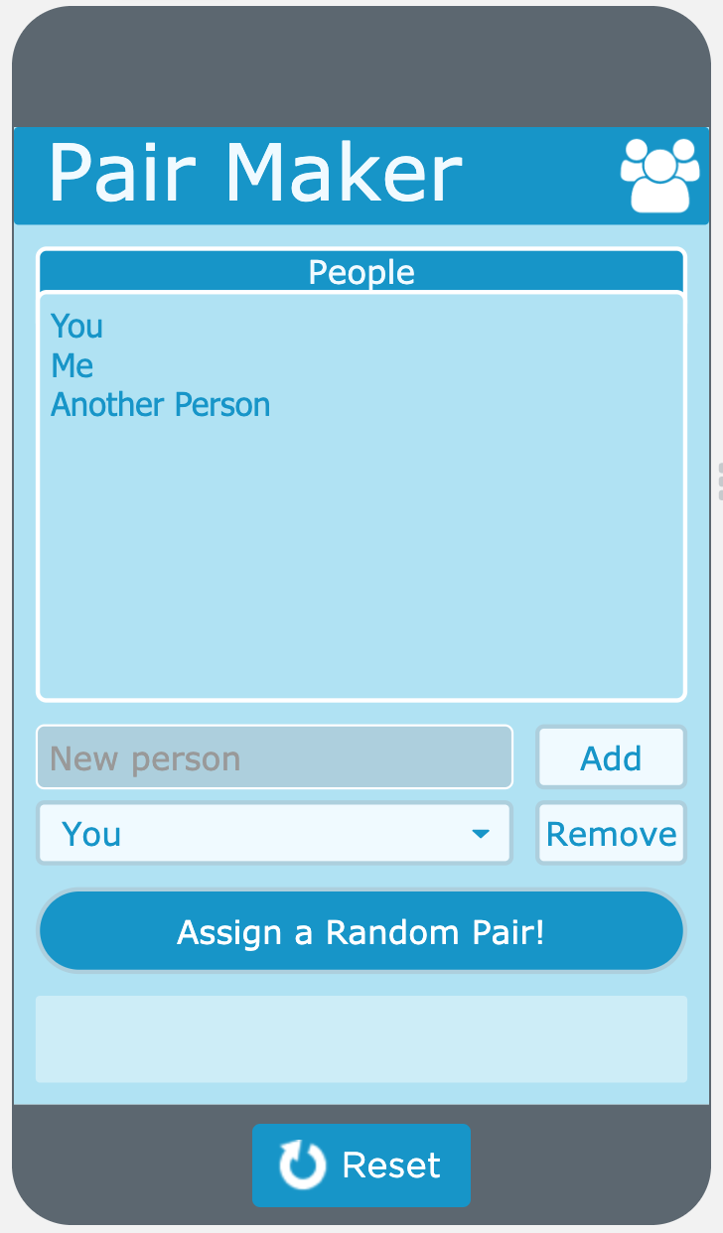
Unit 5 Lesson 2 - Activity
Do This:
All groups read the Pair Maker app and respond to the questions.
Be ready to discuss your responses with another group.

