Slide 1
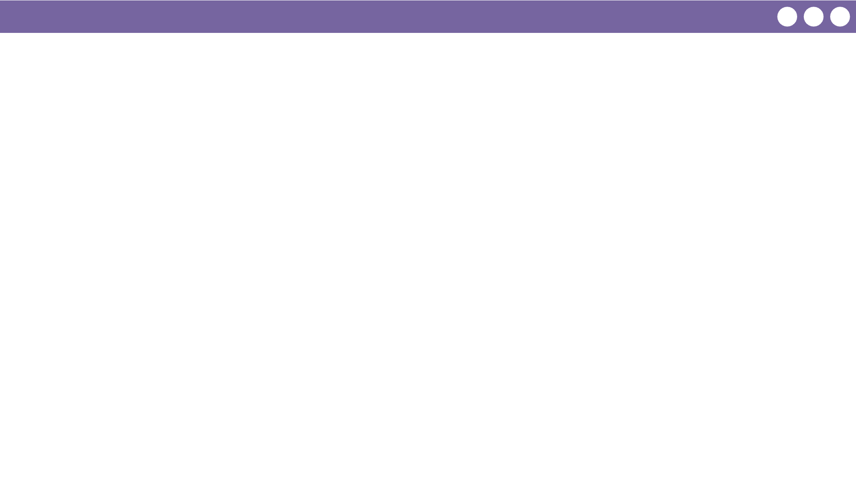
Unit 5 Lesson 2 - Wrap Up
Prompt:
What aspects of using lists do you feel you already understand? What questions do you want to dig into more tomorrow during the practice lesson?

