Slide 1
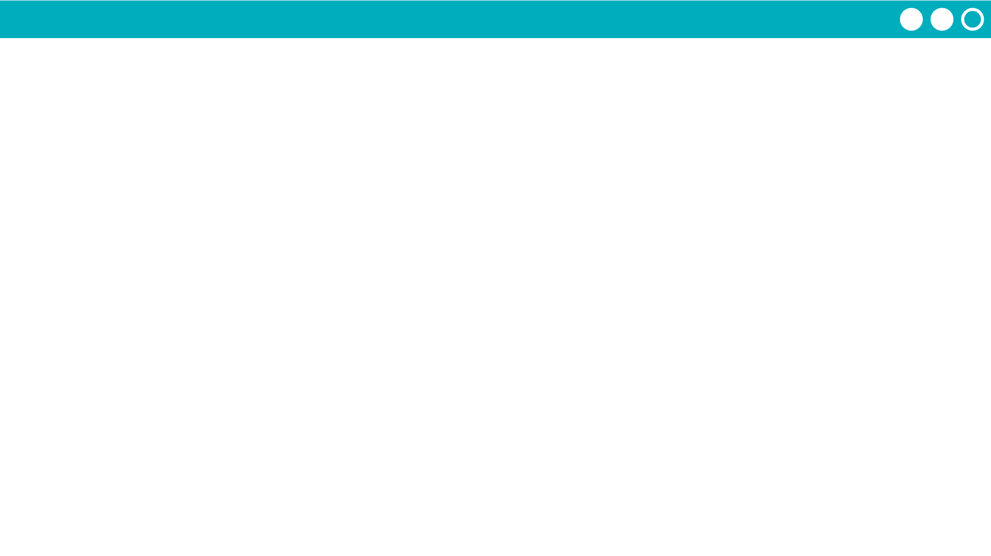
Unit 5 Lesson 3 - Activity
Debugging Lists
Use console.log to track lists in the Debug Console. Click the arrow to see elements listed by index.

