Slide 1

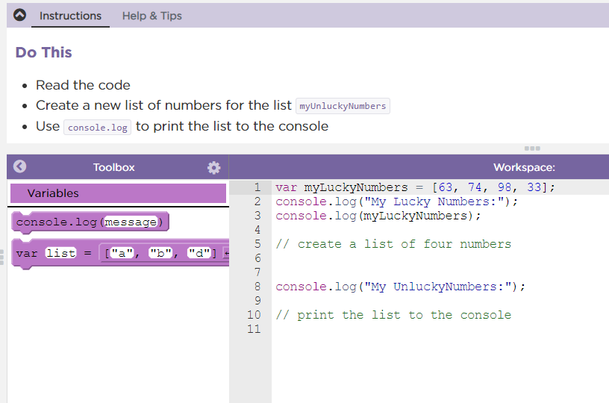

Unit 5 Lesson 3 - Activity
Lists Practice
Do This:
Navigate to Lesson 3, Level 1 on Code Studio

