Slide 1

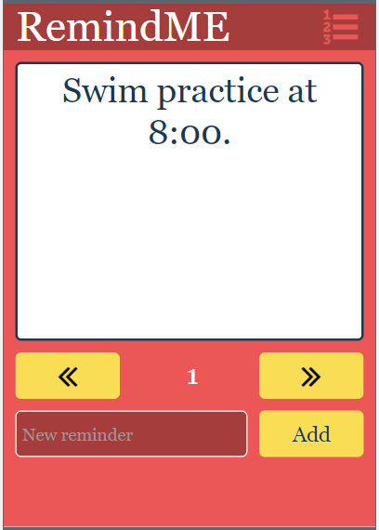

Unit 5 Lesson 4 - Activity
Lists Make:
Reminder App
Do This:
Navigate to Lesson 4, Level 1 on Code Studio

