Slide 1
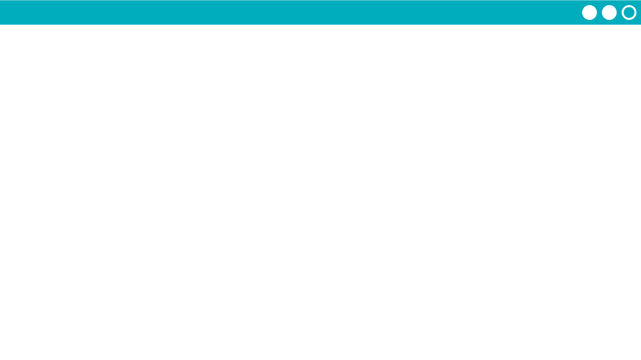
Unit 5 Lesson 4 - Activity
Do This:
Try using the app.
Add several reminders to the app.
Scroll through your reminders.
Prompts:
How many lists do you think are needed to make this app work?
What programming patterns with lists do you think you'll need to use?

