Slide 1

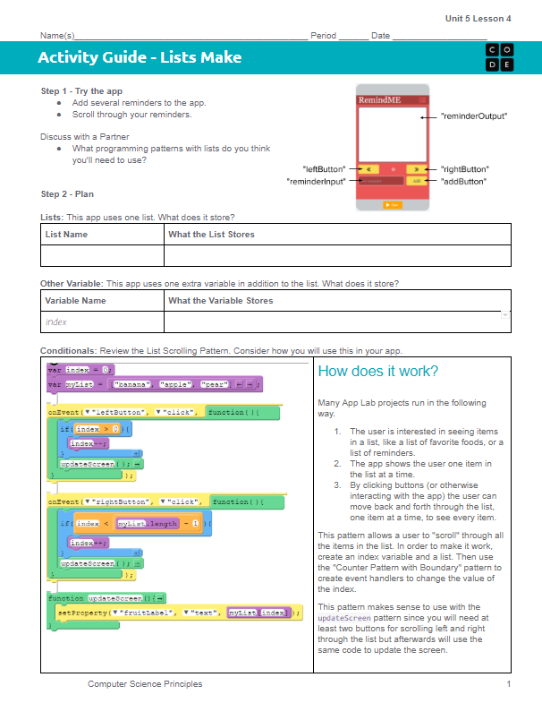
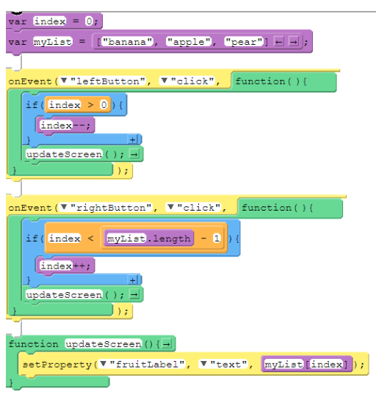
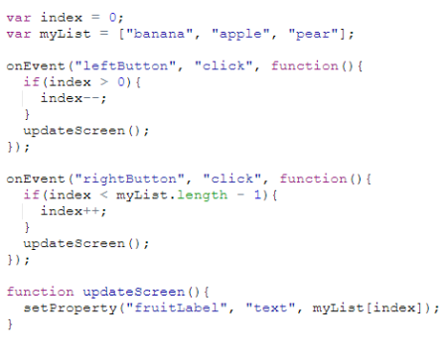
Unit 5 Lesson 4 - Activity
Do This: Make the Reminder App!
The List Scrolling Pattern

