Slide 1

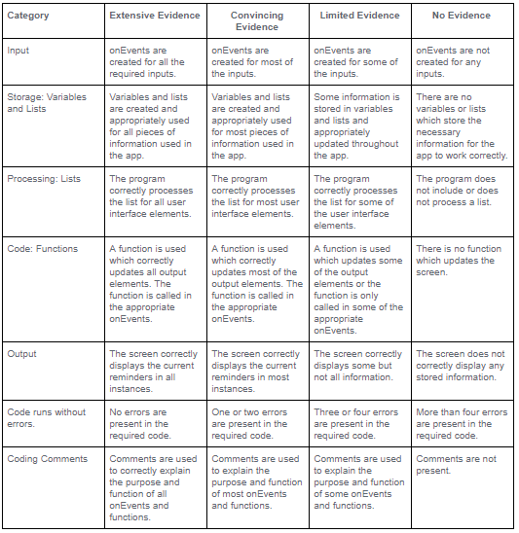
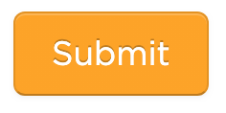
Unit 5 Lesson 4 - Activity
Don't forget to check the rubric before hitting submit!

