Slide 1

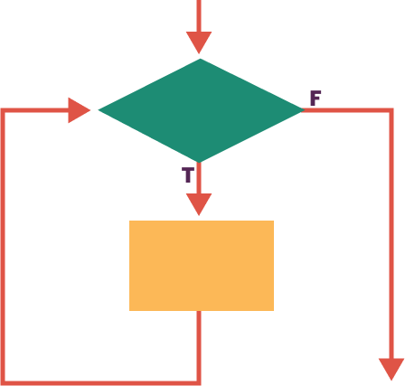
Unit 5 Lesson 5 - Activity
Here’s how it works:
While something is true, the code in the while loop runs, over and over until that thing is no longer true.
Let’s try it!

