Slide 1

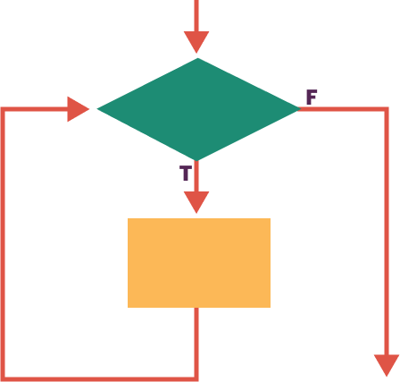
Unit 5 Lesson 5 - Wrap Up
iteration: a repetitive portion of an algorithm which repeats a specified number of times or until a given condition is met.
infinite loop: occurs when the ending condition will never evaluate to true. In other words, the Boolean expression will never evaluate to false.

