Slide 1

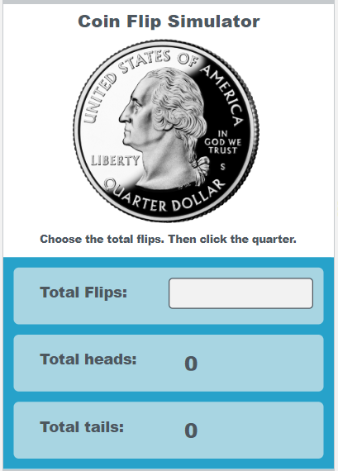
Unit 5 Lesson 6 - Activity
Do This:
With a partner
Navigate to Lesson 6, Level 1
Run the app

