Slide 1

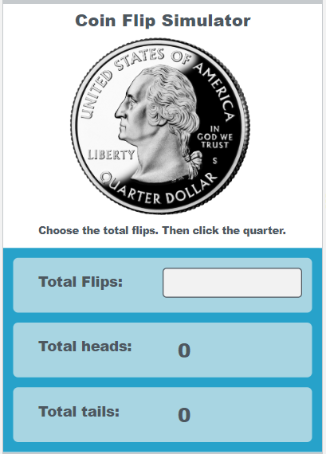
Unit 5 Lesson 6 - Activity
Discuss:
What information does the user input?
How does the app process that information?
What is being repeated? Where is there an opportunity to use a loop?
What information does the app output?

