Slide 1
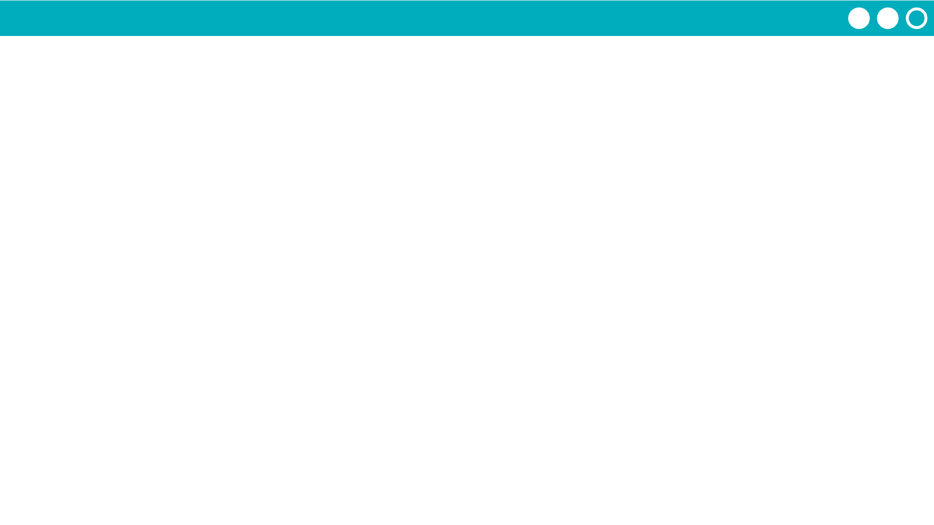
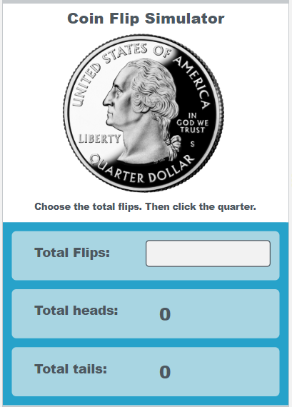
Unit 5 Lesson 6 - Activity
Do This:
Navigate to Level 2
Run the program, watch the code run, and carefully read each individual part of the program

