Slide 1

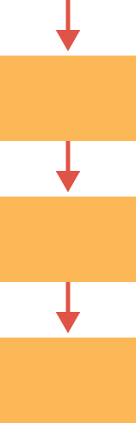
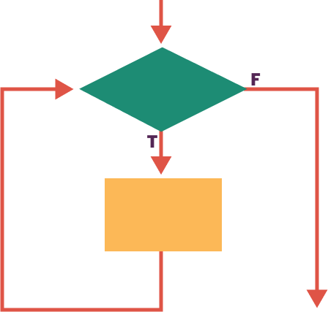
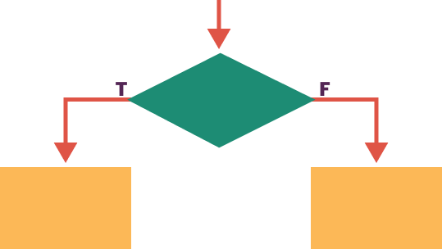
Unit 6 Lesson 1 - Wrap Up
Problem: a general description of a task that can (or cannot) be solved with an algorithm
Algorithm: a finite set of instructions that accomplish a task.
There are usually many algorithms to solve the same problem, and many ways to write or express one algorithm including natural language, psuedocode, diagrams, and are implemented using programming code. All algorithms can be created by combining steps in three different ways.
Sequencing Putting steps in an order
Selection Deciding which steps to do next
Iteration Doing some steps over and over

