Slide 1
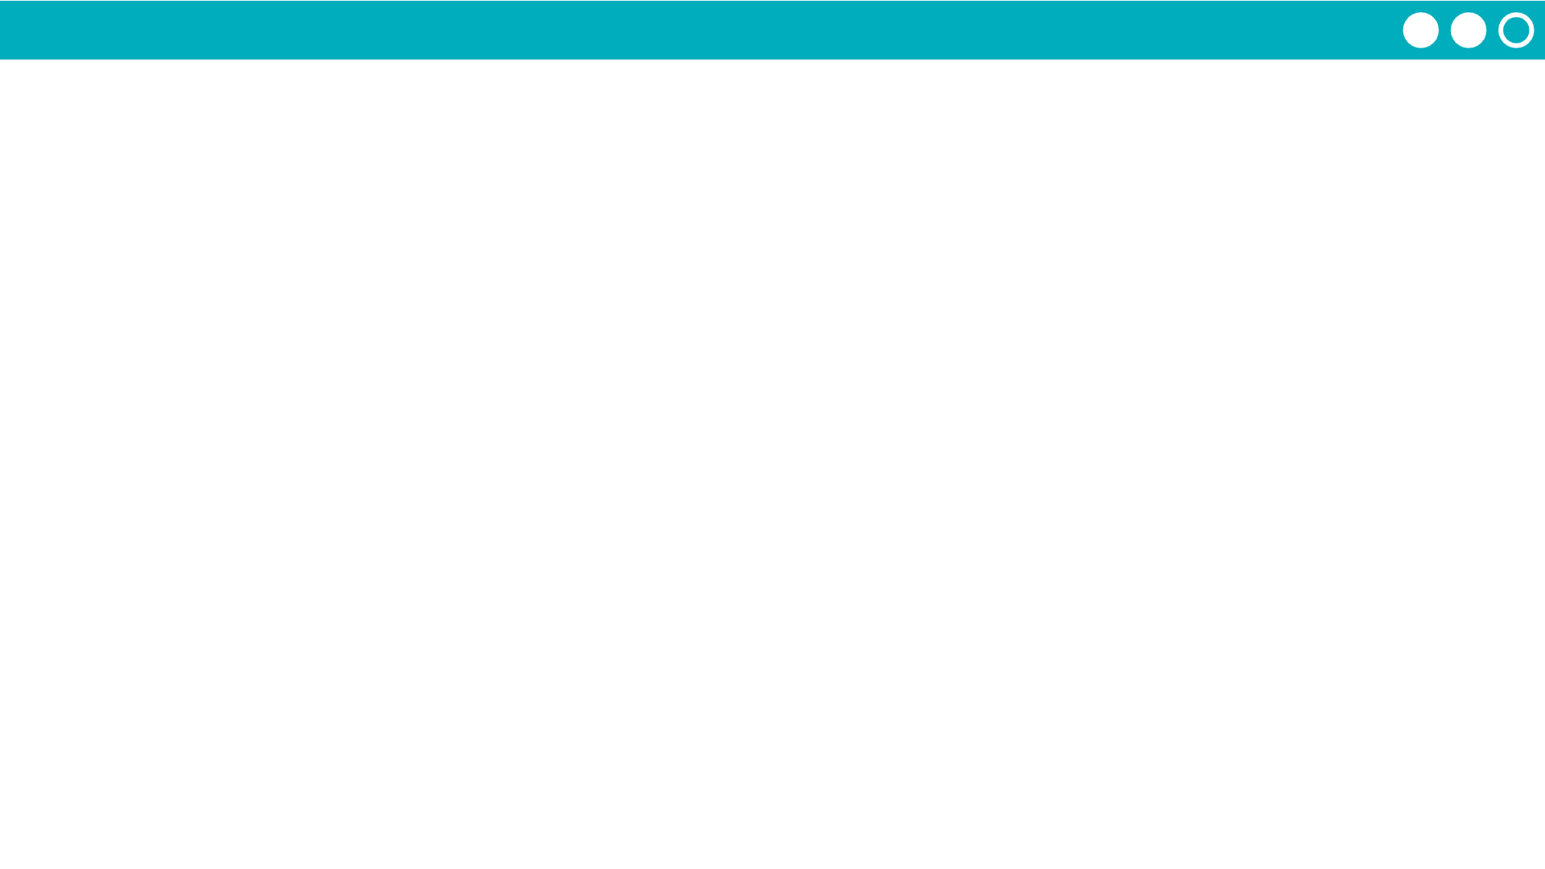
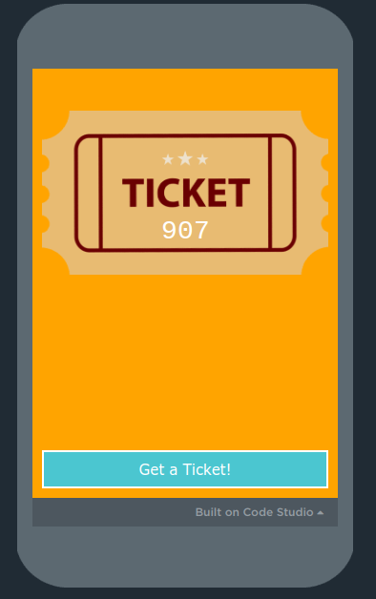
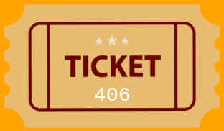
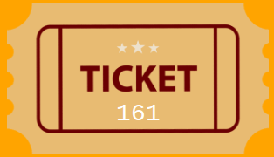
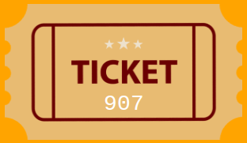
Unit 6 Lesson 2 - Activity
3 Volunteers:
Navigate to the second level on Code Studio.
Click to generate your raffle ticket number.
Write the number on a sticky note.
Come up to the front of the room.

