Slide 1

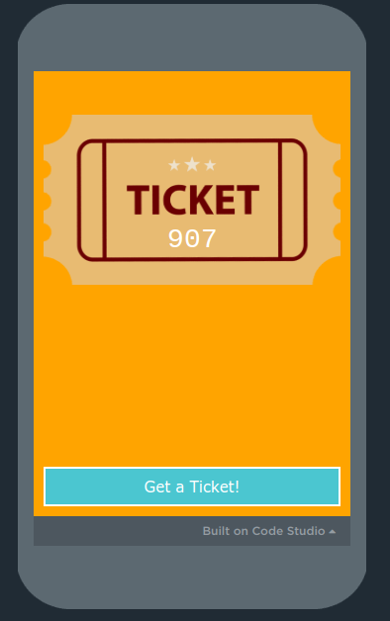
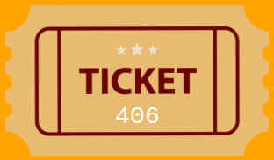
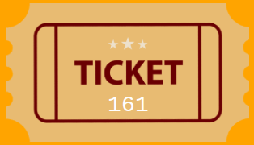
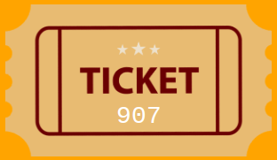
Unit 6 Lesson 2 - Activity
Problem: Figure out if anyone has the winning raffle ticket
Instance: A list of tickets plus the winning number
Let's check if anyone has the winning number!
Do This: Check for the winning number, by revealing your numbers, one by one.

