Slide 1
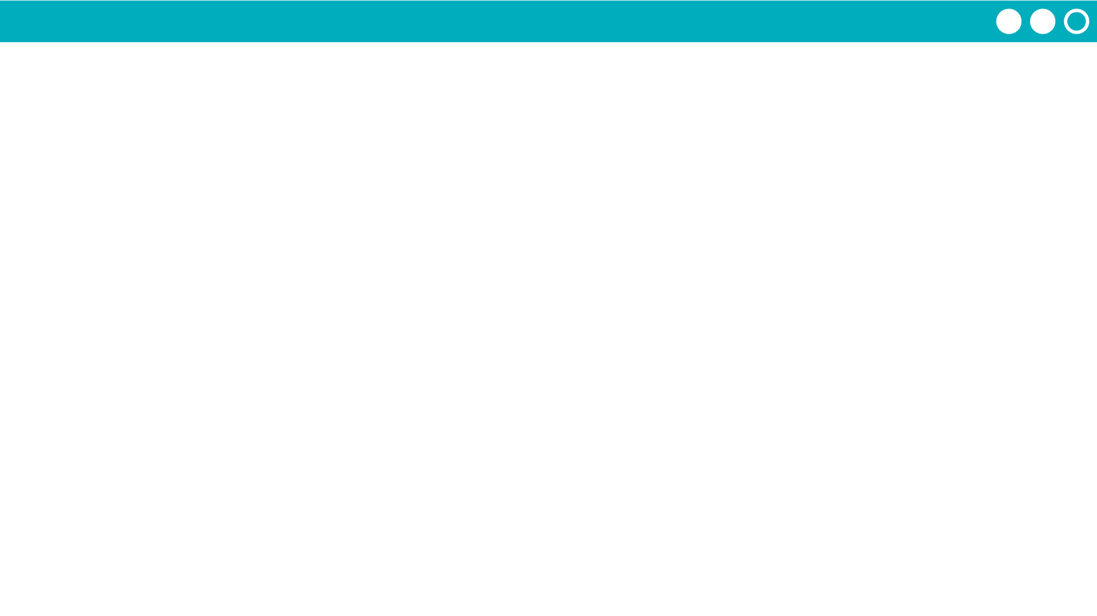
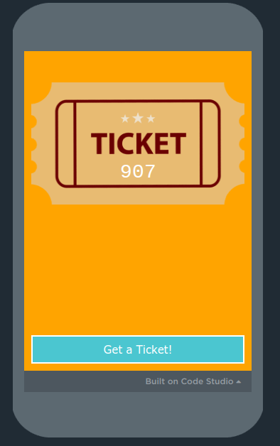
Unit 6 Lesson 2 - Activity
With a partner…
Do This:
Use the ticket generator to generate seven tickets. Write down the numbers on separate sticky notes.
Organize the sticky notes in numerical order.
Copy one of the numbers on to a separate sticky note. This is the number you are searching for.
705
232
705
716
833
117
245
410

