Slide 1
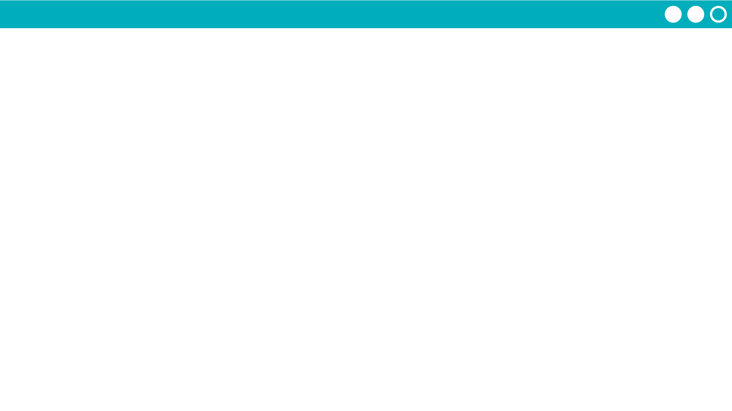
Unit 6 Lesson 2 - Activity
🔍
705
Binary Search:
We found the number! 705 is in the list.
705
705
705
compare
compare
compare
GREATER THAN
EQUAL TO!
LESS
THAN
232
705
716
833
117
245
410
STEP 1
STEP 3
STEP 2

