Slide 1

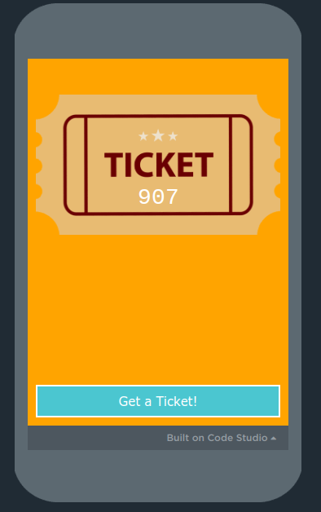
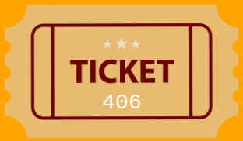
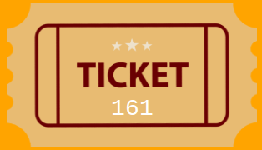
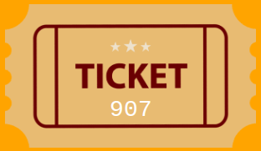
Unit 6 Lesson 3 - Activity
The Pair Raffle
The winners are any two tickets that adds to the winning number.
The winning number is 1000.
Do This
Generate a ticket
Silently move around the room.
See if you’re a part of a winning pair!

