Slide 1
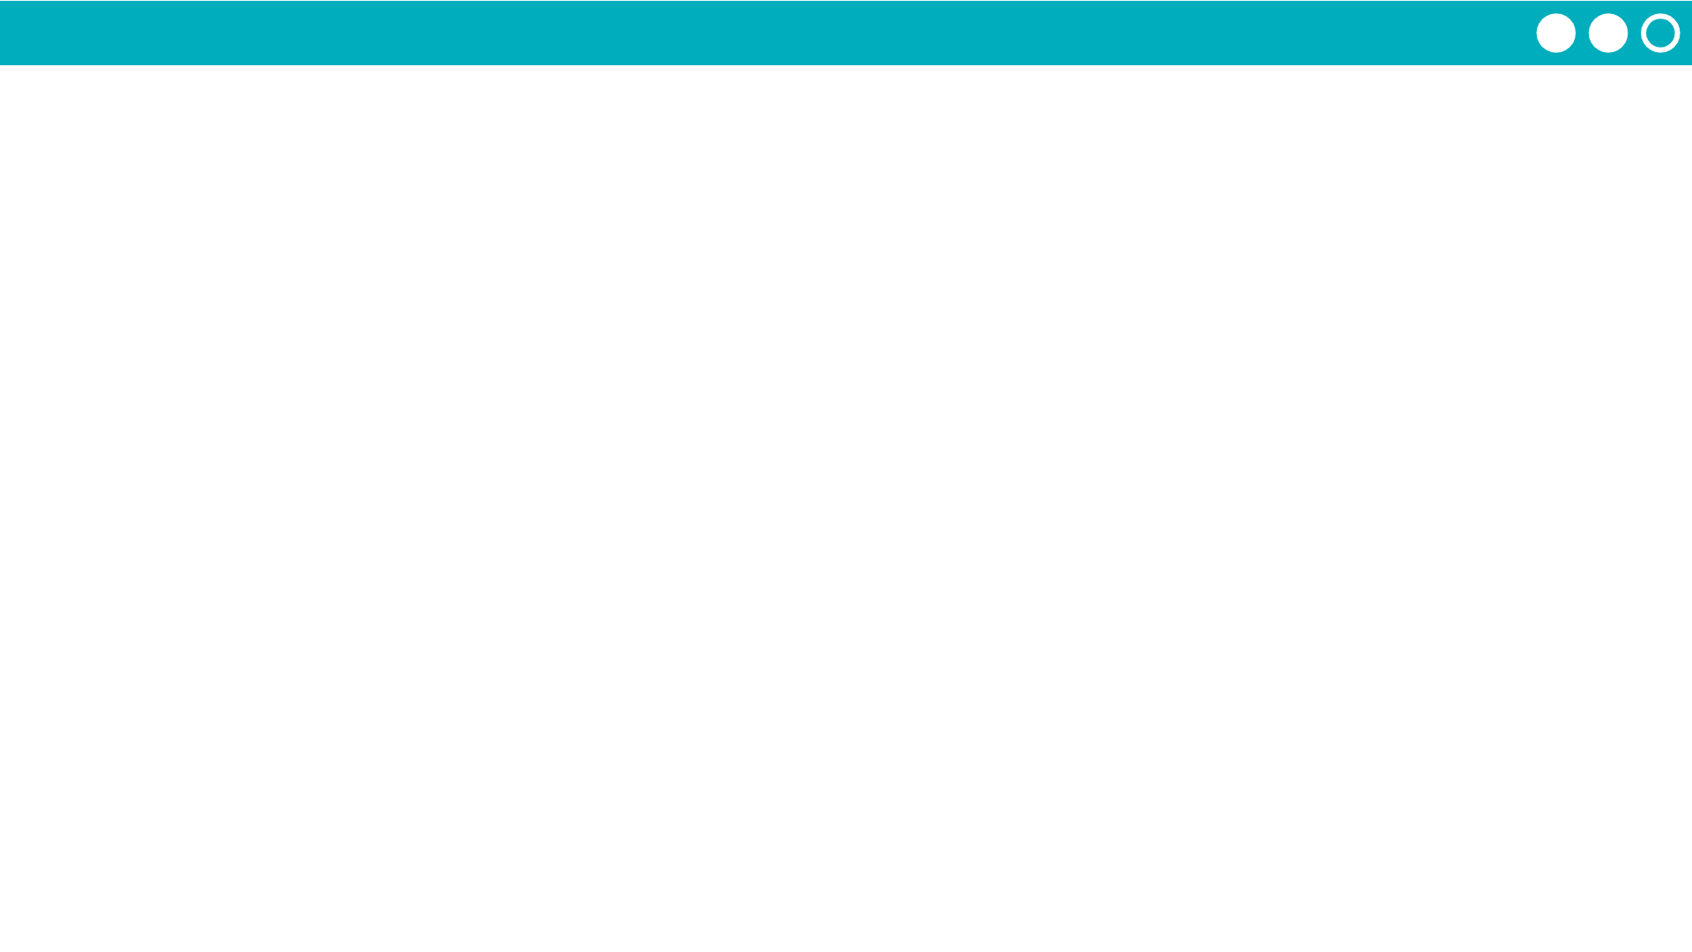
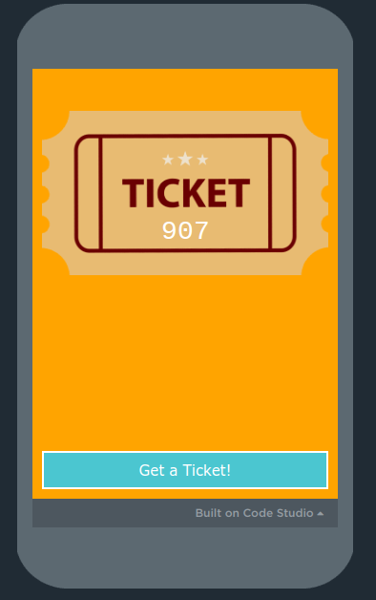
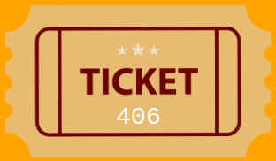
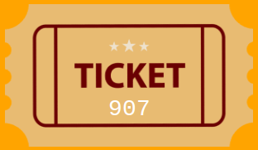
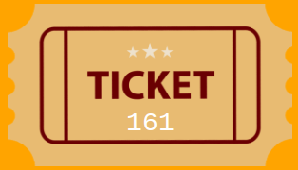
Unit 6 Lesson 3 - Activity
The Group Raffle
The winners are any group of (from one ticket up to all of them) that adds to the winning number.
The winning number is 2500.
Do This
Generate a ticket
Move around the room (you can talk this time
See if you’re part of a winning group!

