Slide 1

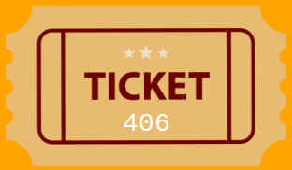
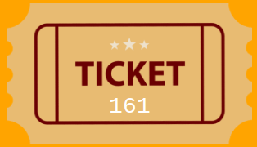
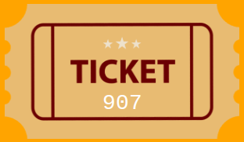
Unit 6 Lesson 3 - Activity
We could write an algorithm that goes through every possible “check” for the pair raffle or the group raffle.
Let’s see how many checks there are!
With your partner fill in the two tables on the activity guide.

