Slide 1

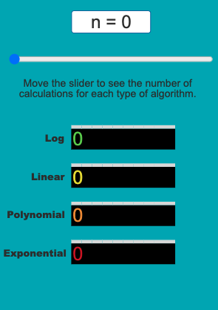
Unit 6 Lesson 3 - Activity
Reasonable or Unreasonable Time?
Click run to start the app.
Move the slider and see what happens.
← Sorted Raffle
← Normal Raffle
Discuss with a partner:
Which of these algorithms run in a reasonable amount of time?
Which run in an unreasonable amount of time?
← Pair Raffle
← Group Raffle

