Slide 1

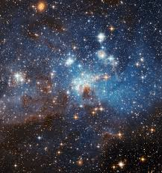
Unit 6 Lesson 3 - Activity
Tickets | Sorted Raffle log | Normal Raffle linear | Pair Raffle polynomial | Group Raffle exponential
10 | 4 Checks | 10 checks | 100 checks | 1,024 checks
20 | 5 checks | 20 checks | 400 checks | 1,048,576 checks
100 | 7 checks | 100 checks | 10,000 checks | 1.26 * 10³⁰ checks
1000 | 10 checks | 1,000 checks | 1,000,000 checks | 1.07 * 10³⁰¹ checks
10,000 | 14 checks | 10,000 checks | 100,000,000 checks | 2.00 * 10³⁰¹⁰ checks
100,000 | 17 checks | 100,000 checks | 10,000,000,000 checks | 9.99 * 10³⁰¹⁰² checks
At this point there are more checks than atoms in the universe
Polynomial is bad but exponential gets unreasonably large extremely quickly.

