Slide 1

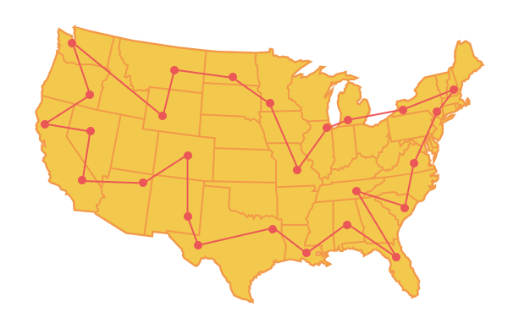
Unit 6 Lesson 4 - Activity
The Traveling Salesman Problem can be solved with an algorithm, which checks each possible option.
BUT, it would take massive amounts of computing power to compare every single option, especially as the number of homes to visit (otherwise known as nodes) increases.
Therefore, it would take an unreasonable amount of time for the solution to be calculated for most instances of the problem.

