Slide 1

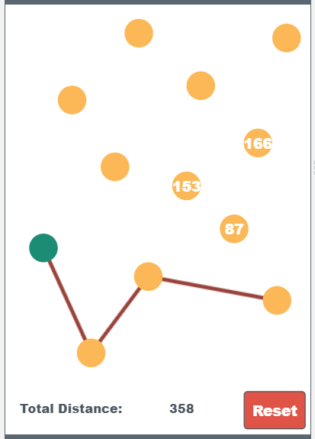

Unit 6 Lesson 4 - Activity
Do This:
Navigate to Level 1 on Code Studio
Try to find the "best" path to visit all nodes.
Write down a plan or heuristic for choosing a good path.
Note: your heuristic may not always find the best path, but it should be close enough
AP CSP
Journal

