Slide 1

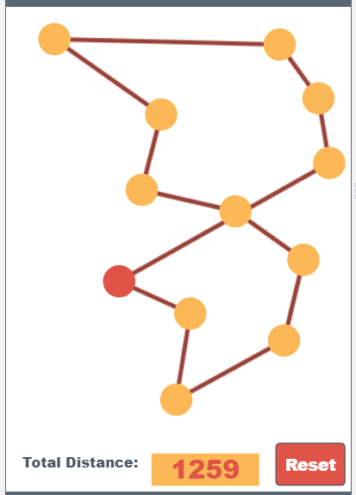
Unit 6 Lesson 4 - Activity
Sample Heuristic:
At each node, travel to the next closest node
Is this "good enough"?
9
10
8
11
7
12
6
5
1
4
2
3

