Slide 1

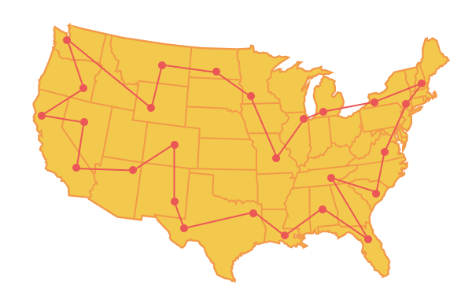
Unit 6 Lesson 4 - Activity
Takeaways:
The Traveling Salesman Problem is an optimization problem. We are attempting to find the best path.
It is also unreasonable because there is not an algorithm that can solve the problem in a reasonable amount of time.
We need to use a heuristic to come up with a solution that is "good enough" for most instances of the problem.

