Slide 1

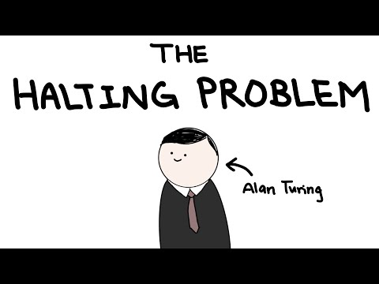
Unit 6 Lesson 4 - Activity

