Slide 1

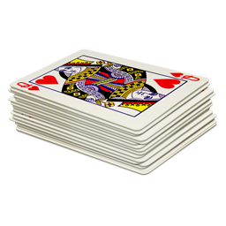
Unit 6 Lesson 5 - Activity
Parallel Algorithms and Speedup
Groups: Get into groups of 3 or 4
Each group should have a deck of cards

