Slide 1

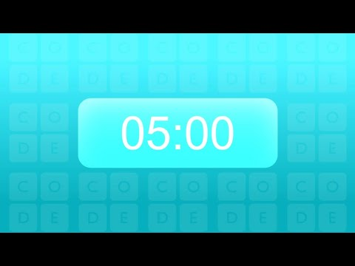
Unit 6 Lesson 5 - Activity
Challenge Three - Full Group Sort
Shuffle the cards
Put them in a neat stack, face down
As quickly as you can, get the cards sorted so all the red cards are at the bottom and all the black cards are at the top.
Time stops when you have the cards sorted and back in a neat stack.
This time your entire group (three or four people) can sort the cards.
Record the best time in your group

