Slide 1

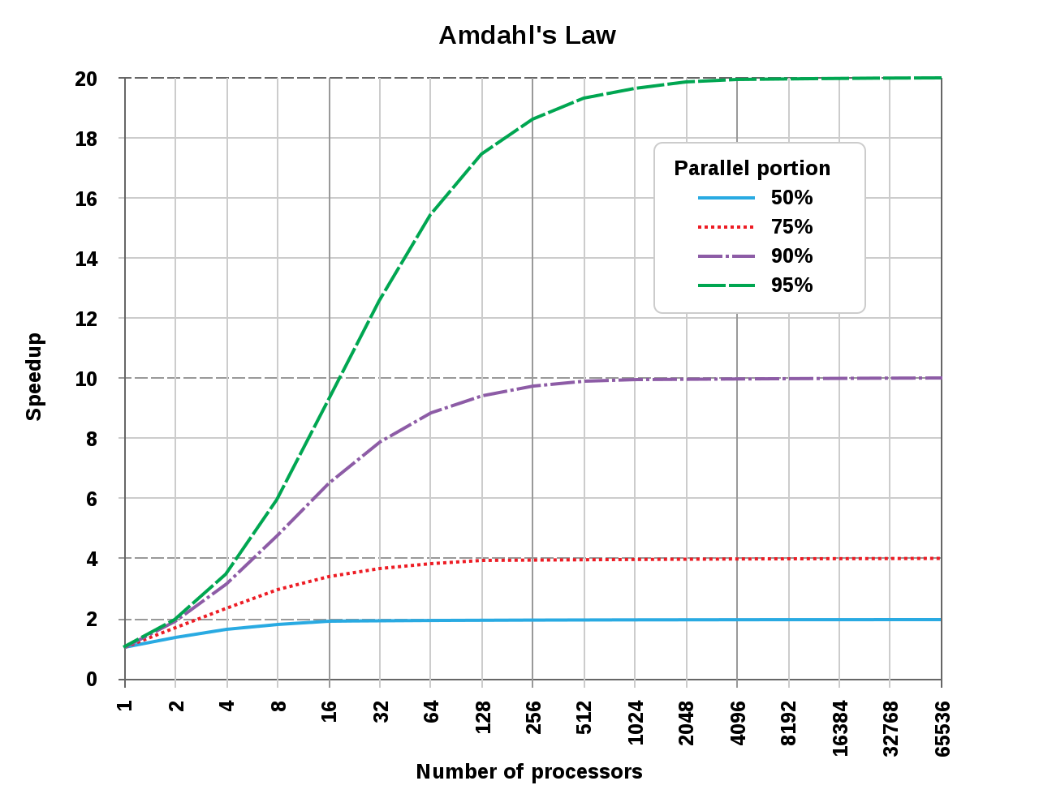
Unit 6 Lesson 5 - Activity
It’s not just you! Speed-up is never equal to the number of processors.
Some portions of your algorithm can’t be made parallel. Each additional processor helps a little less. Eventually the speedup reaches a limit.

