Slide 1
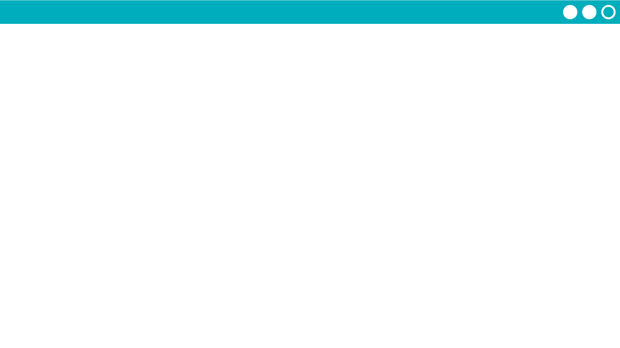
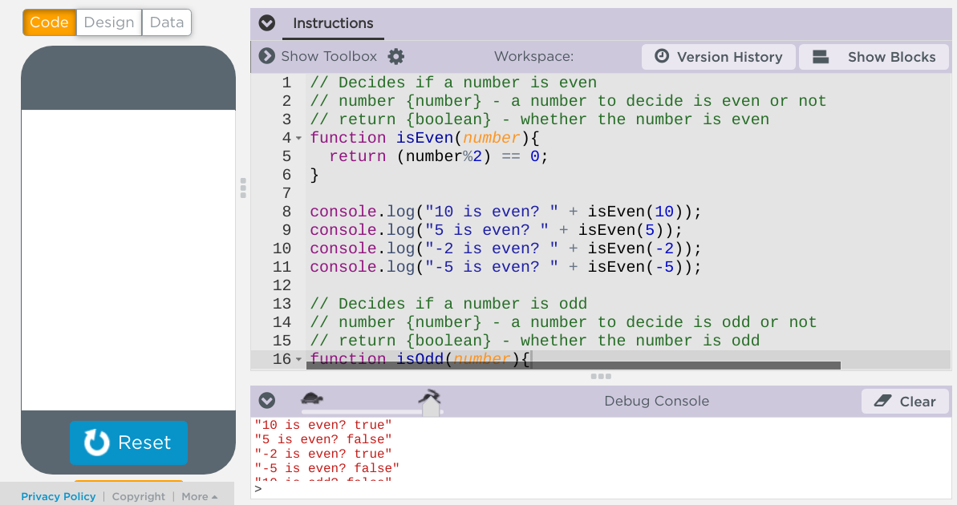
Unit 7 Lesson 7 - Activity
Testing Functions
Use console.log to write tests of the function. Try different values to make sure your function works in many cases.
Check the results in the console to make sure that the functions pass the test.

