Slide 1

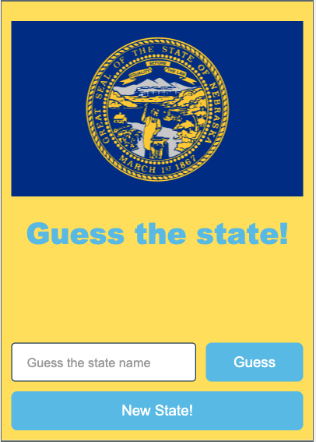

Unit 7 Lesson 7 - Activity
Libraries Practice
Do This:
Navigate to Lesson 7, Level 1 on Code Studio

