Slide 1
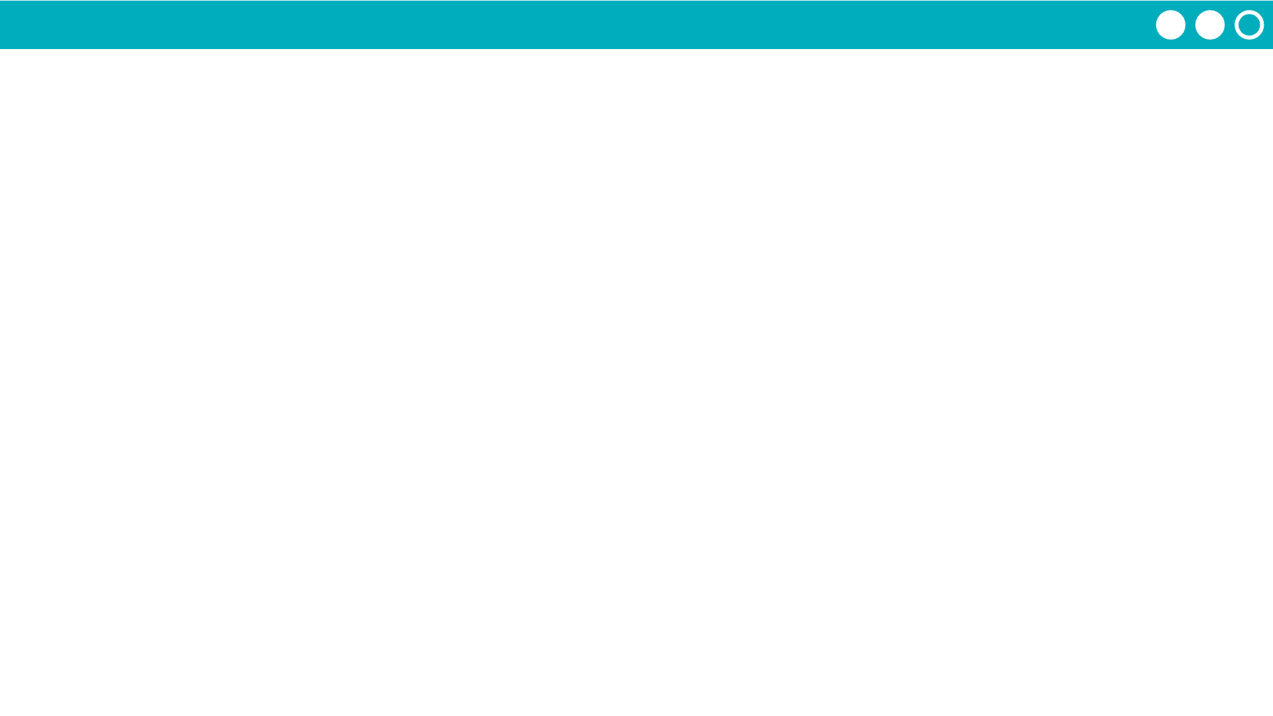
Unit 7 Lesson 1 - Activity
Argument - the value passed to the parameter
3
“lemon”
tiers
flavor
makeCake
3
“lemon”
Parameter - a variable in a function definition. Used as a placeholder for values that will be passed through the function.

