Slide 1
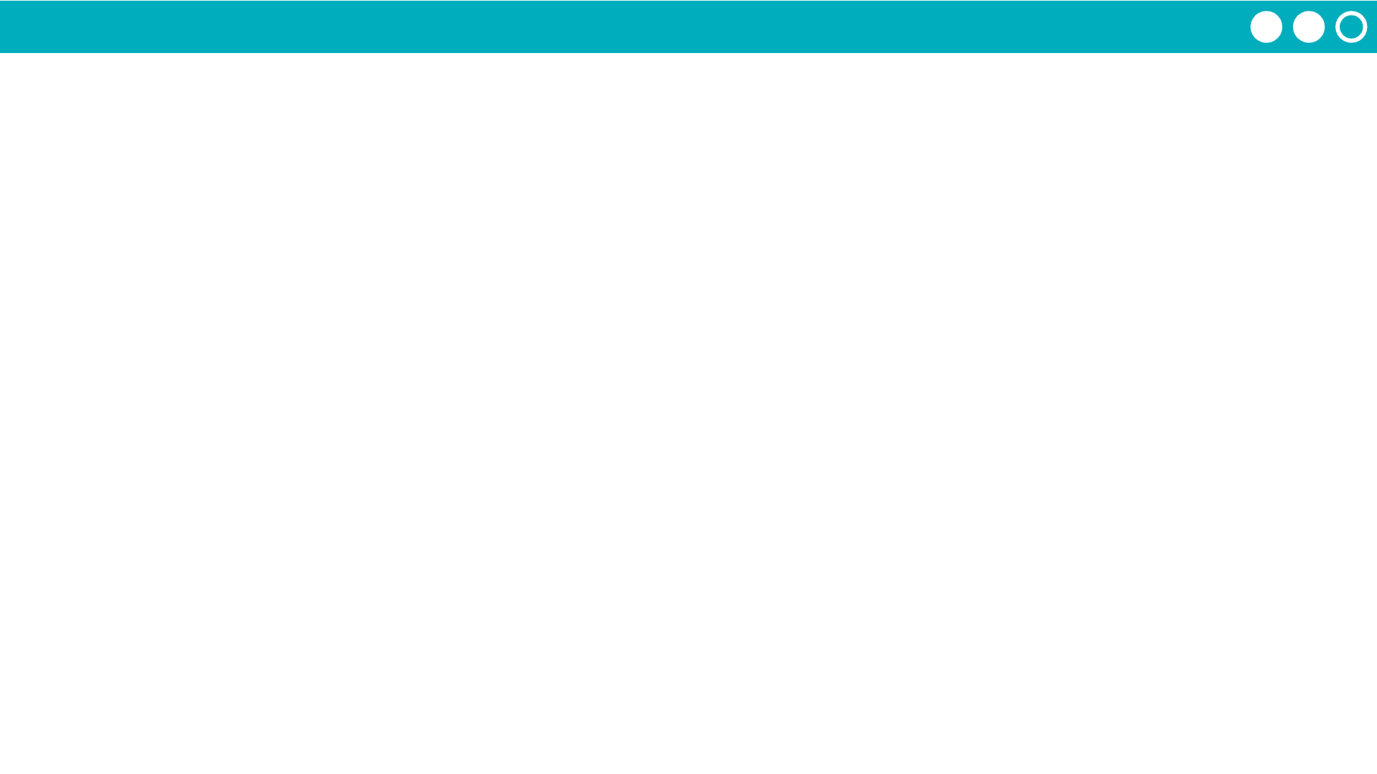
Unit 7 Lesson 8 - Activity
Step 2 - Design
Choose 2 or more functions you'd like to build.
At least one needs a parameter, return, loop, and if-statement
Fill in step 2 of the Project Guide

