Slide 1
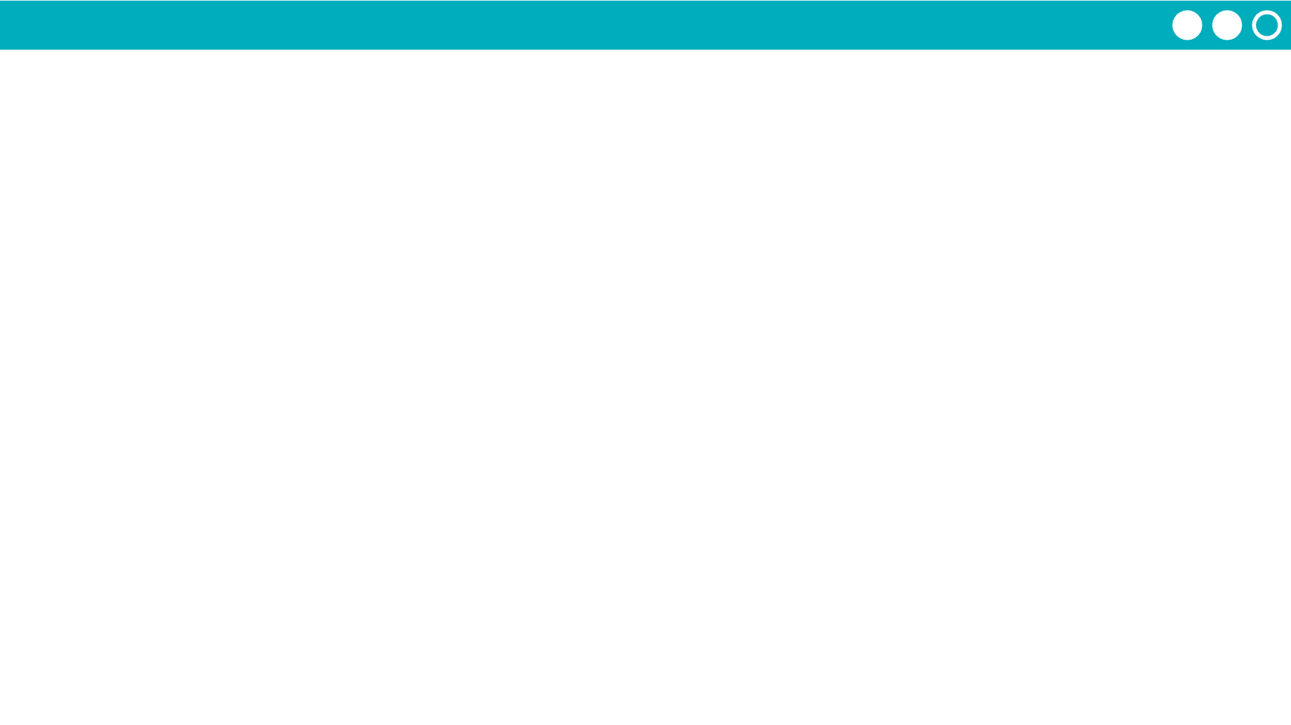
Unit 7 Lesson 8 - Activity
Step 3 - Build
Use the rest of your time today to build out the functions you designed.

