Slide 1

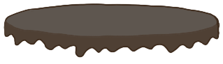
Unit 7 Lesson 1 - Activity
What if I wanted a four layer chocolate cake? What would that look like?
4
“chocolate”
tiers
flavor
makeCake
4
“chocolate”

