Slide 1
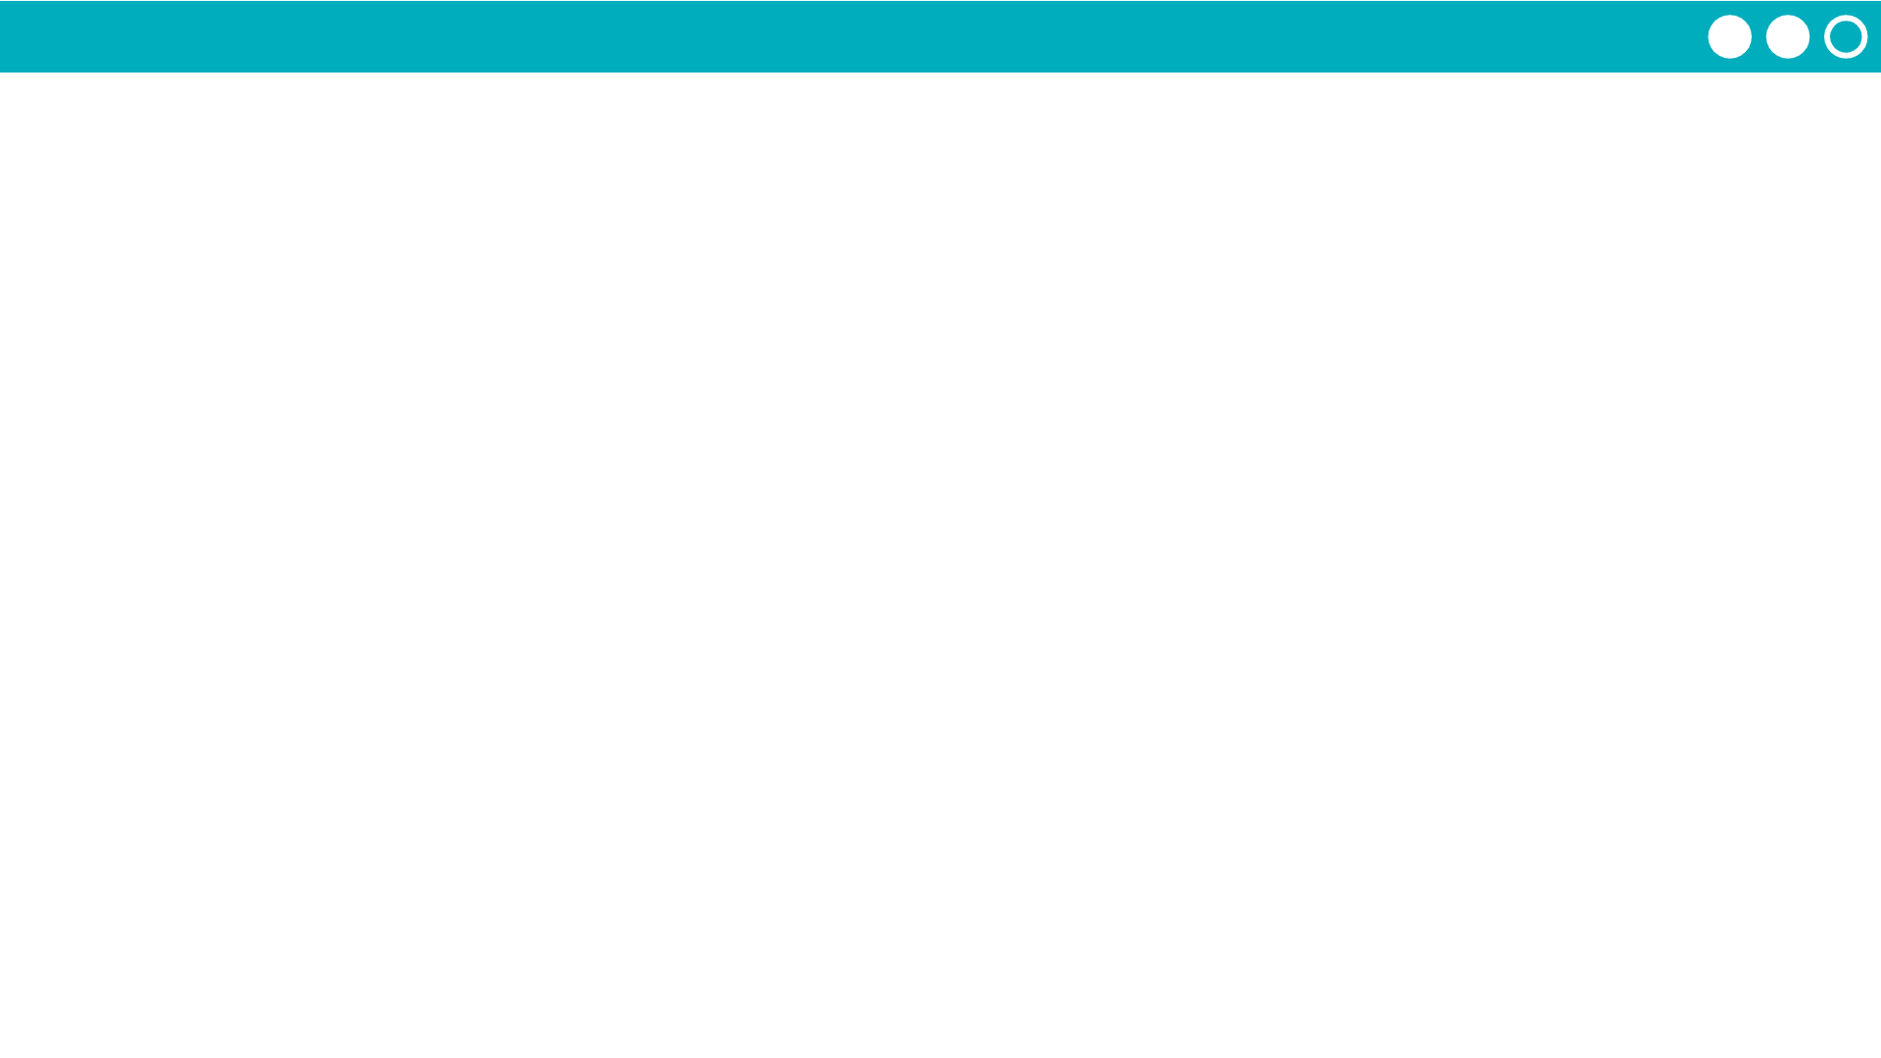
Unit 7 Lesson 9 - Activity
Step 4 - Test
As your program today, add tests to your functions to make sure they're working as you expect
Keep writing your library

