Slide 1

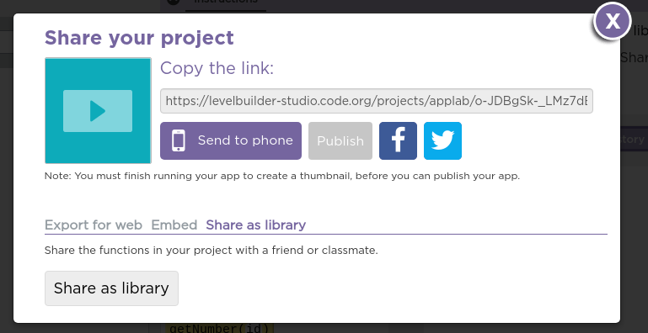
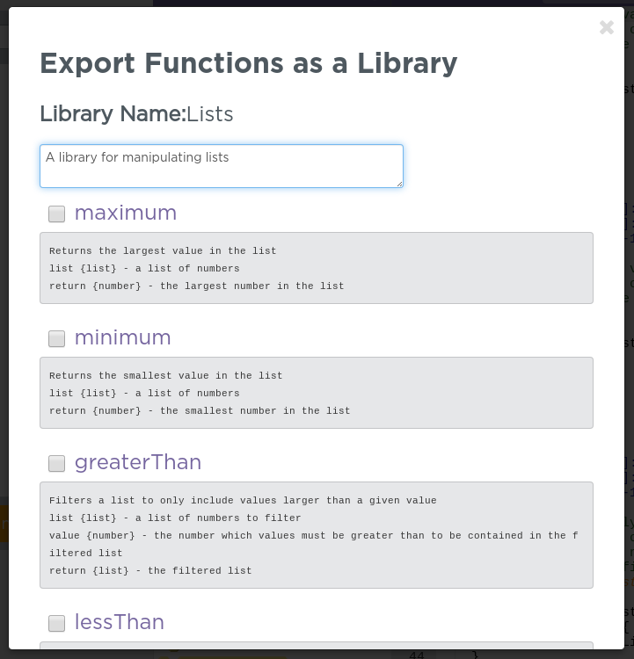
Unit 7 Lesson 9 - Activity
Step 5 - Feedback - Export Your Library
In Lesson 9, Level 1 click Share → Show Advanced Options → Share as Library
Choose the functions you'd like to export. If you need to edit the comments before your functions do so.
Hit Publish

