Slide 1
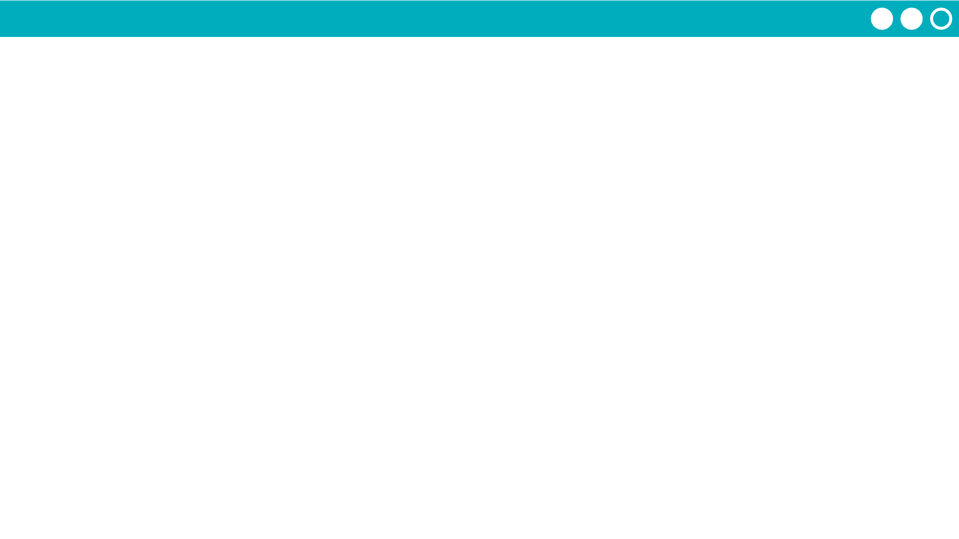
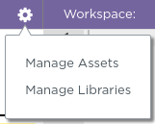
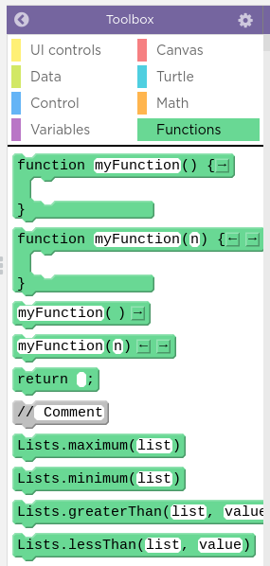
Unit 7 Lesson 9 - Activity
Step 5 - Feedback - Import a Library
Go to the next level, Lesson 9 Level 2
Click the gear and then Manage Libraries
Find your partner's library and import it
Start testing the different functions they shared with you. They'll be in the "Functions" drawer

