Slide 1
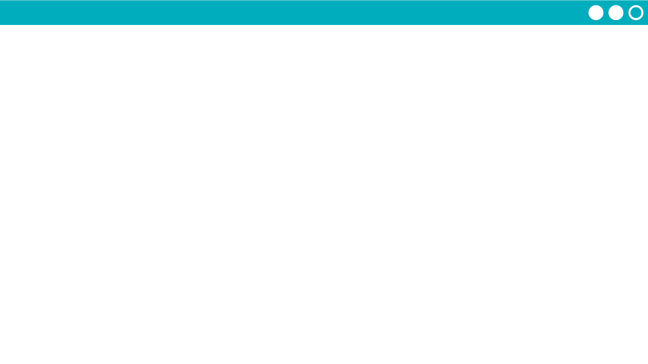
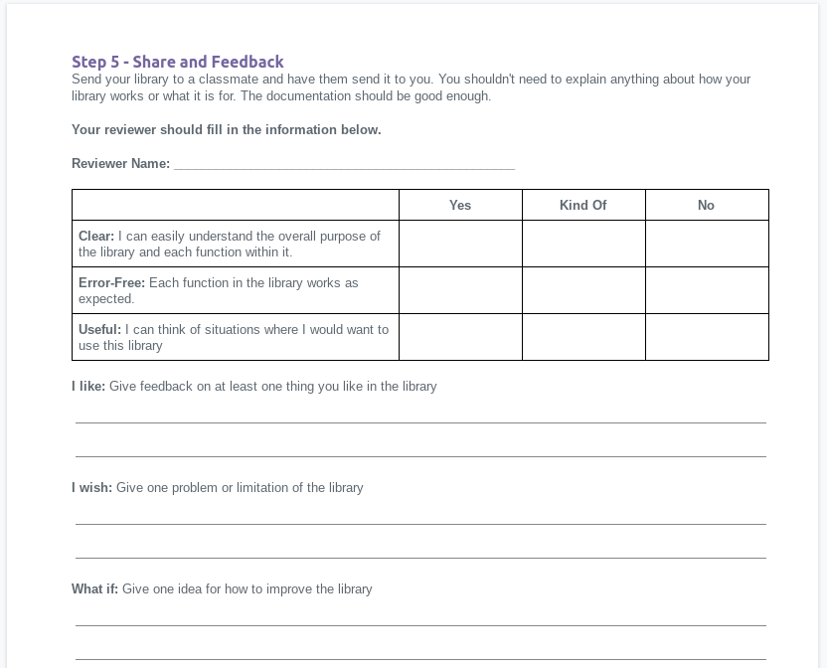
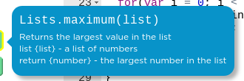
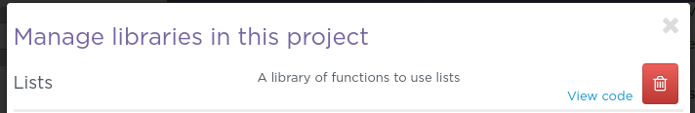
Unit 7 Lesson 9 - Activity
Step 5 - Feedback - Give Feedback
On your classmate's project guide give them feedback about their library.
Hover over blocks to read their documentation
You can view all the library code by clicking "View Code" from the "Manage Libraries" window

