Slide 1
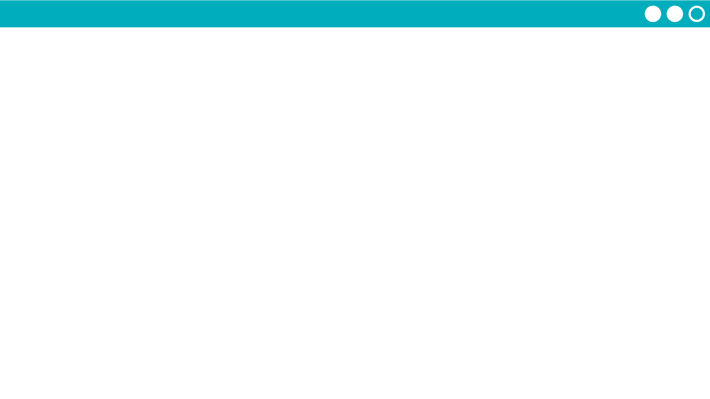
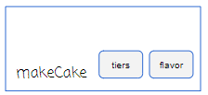
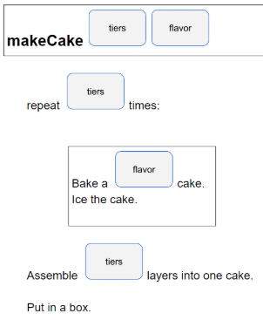
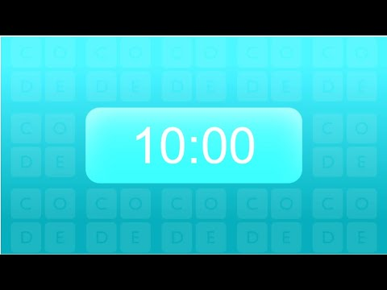
Unit 7 Lesson 1 - Activity
Do This: Time to create your own function with parameters!
Complete Challenge #1 in your Activity Guide

